Slide 1

AHPRA
Review of stakeholder perceptions of AHPRA and the National Boards
A Social Research Project
November 2018

Slide 2
An overview of the methodology
A four stage approach that combined both qualitative and quantitative research approaches has been used.
Stage 1 comprised a total of 53 qualitative interviews. This consisted of interviews with the Chair of every National Board (15); the Executive Officer of almost every National Board (13), Government health providers (3); major health employers (3); Aboriginal and Torres Strait Islander Health Strategy group representatives (5); Co-regulatory partners (4); Professions Reference Group members (3); representatives from CALD communities (2) and ‘Other’ various stakeholders (5).
These interviews were conducted between August 10 and September 26, 2018.
Stage 2 involved three focus groups. The three groups were conducted with i) Members of the Community Reference Group; ii) Members of the Professions Reference Group and iii) Accreditation Authority representatives.
These groups were conducted between August 14 - 22, 2018.
Stage 3 consisted of an online survey with practitioners from all 15 registered professions.
This survey was conducted between September 17 – 25, 2018.
Stage 4 consisted of an online survey with a representative sample of the Australian general public.
This survey was conducted between September 17 – 25, 2018.

Slide 3
A range of stakeholders have been consulted
Throughout this report, ‘internal stakeholders’ is used to refer to Chairs of National Boards and AHPRA Executive Officers, while, ‘external stakeholders’ is generally applied to infer other stakeholder groups
The general public
Registered health practitioners
Government health providers (Deputy Secretaries).
Major health employers (CEOs and/or policy directors).
Co-regulator partners and health complaints entities (leaders, commissioners, ombudsmen, organisational leaders)
CRG and PRG.
Aboriginal and Torres Strait Islander Health Strategy group.
CALD community representatives.
Accreditation liaison representatives
National Board Executive Officers
Chairs of National Boards
Agency Management Committee representative
EXTERNAL STAKEHOLDERS INTERNAL STAKEHOLDERS
(consulted quantitatively through online surveys) (consulted qualitatively through depth interviews and focus groups)

Slide 4

Qualitative approach
  The participants for the in-depth interviews were identified by the Project Team within AHPRA and represented a combination of both internal and external stakeholders.
  Contact with the stakeholders was initially made by the AHPRA Communications Team and an email was sent to stakeholders to seek assistance and encourage involvement. The email provided background to the project and introduced Truly Deeply. Stakeholders were then contacted directly by Truly Deeply to arrange interviews.
  To accommodate the availability of participants, the majority of interviews were conducted over the phone and typically lasted around 30 minutes. The Appendix to this report identifies the titles of the interviewed stakeholders.
  The face to face interviews (with Board Chairs’) as well as the focus groups were conducted in meeting rooms at the AHPRA head office in Bourke St, Melbourne.

Slide 5

Quantitative approach
  Online surveys were conducted with practitioners as well as the broader community following the qualitative investigation.
  Truly Deeply developed the questionnaires in consultation with AHPRA.
  The questionnaires were developed to allow initial findings in the qualitative approach to be further explored and validated. Additional pre-codes and lists of words and statements were included in the survey following feedback from interviews and discussion with stakeholders.
  Respondents to the Community Survey were sourced using an external panel provider. Quotas were placed on the sample for gender, age and location to ensure a nationally representative sample was achieved.
  Participants in the Practitioner Survey were sourced by AHPRA (using software that allowed the survey to be deployed to a random sample of practitioners in each profession).
  Once the surveys were closed, statistical analysis was conducted by Truly Deeply to summarise and compare the quantitative findings.
 | Community Survey | Practitioner Survey
Fieldwork dates | September 19 - 25 | September 19 - 27
Responses | 1,020 | 5,694
Email invitations sent | na | 100,257
Response rate | na | 6.0%

Slide 6
Sample of registered practitioners (n = 5,694)
Gender
Practitioner type*
(n=58)
(n=325)
(n= 437)
(n=464)
Age
(n=461)
(n=326)
(n=300)
(n=304)
(n=339)
(n=349)
(n=373)
Years
in
practice
*Analysis of the ‘total sample’ has been weighted to ensure each of these professions accounts for 6.25% of the total
(n=112)
(n=355)
(n=380)
(n=324)
(n=787)
* Figures may not add to 100%. Missing figures accounted for by ‘prefer not to say’

Slide 7
Sample of registered practitioners (n = 5,694)
Location
1%
19%
Metro: 66%
Regional: 34%
10%
8%
32%
27%
2%
% who have had a complaint ever made against them to AHPRA or their Board as a registered Health Practitioner*
% who have ever been audited to check their compliance with the mandatory registration standards*
* As identified by individual respondents
* As identified by individual respondents

Slide 8
A nationally representative sample of the broader Australian adult population was ensured (n=1,020)
Gender
Location
1%
19%
10%
8%
35%
Age
25%
60% Metropolitan
40% Regional/ rural
2%
NESB
Registered
health
practitioner
Work
Status
* Figures may not add to 100%. Missing figures accounted for by ‘prefer not to say’

Slide 9
Key Insights

Slide 10
We were in the air, flying the plane and building it all at the same time. We have come a long way since then, we have made a lot of decisions and built a lot of the plane. Now we can spread our wings a bit more, on all sorts of things.
The building blocks are well established. There is now an opportunity to change the conversation.
1
2
3
AHPRA and the National Boards are widely respected.
There is a need for a shared vision and more unified public ‘face’.
It’s time to shift the conversation from ‘the punitive’ to ‘the positive’.

Slide 11

1
AHPRA and the National Boards are widely respected.
Stakeholder perceptions of AHPRA and the National Boards are generally positive and consistent.
The broad sentiment is that it was a ‘rough and shaky start’, but a very solid foundation has been built.
The relationships between and among the National Scheme, AHPRA and the National Boards are recognised as highly complex, but it is also widely acknowledged that those relationships have matured, evolved and significantly improved overtime.
The hard work, experience and expertise of the leadership team and senior staff at AHPRA are widely considered to be key reasons for the success and improvements.

Slide 12

2
There is a need for a shared vision and more unified public ‘face’.
While there is confusion regarding the specific roles and functions of AHPRA and the National Boards, that confusion appears to be a concern predominantly to internal stakeholders.
External stakeholders don’t typically understand the complexity of the internal structure, nor do they have an appetite for understanding the complexity. It is clear that misconceptions exist at the most fundamental level about the primary purpose and focus of the National Scheme that should be addressed.
Most external stakeholders perceive AHPRA to be the public face of the National Scheme and the ‘funnel’ for all communication about the National Scheme. Beyond that, there is considerable confusion about what the primary area of interest is for AHPRA and the National Boards. Practitioners are inclined to believe that ‘the public’ are the primary focus for AHPRA while the broader community are more likely to think that practitioners are the primary focus.
Ongoing confidence and trust amongst external stakeholders will rely on communicating a simple, unified story about the key entities, their relationship and key areas of focus.

Slide 13

3
It’s time to shift the conversation from ‘the punitive’ to ‘the positive’.
Much of the hard work in establishing trust and confidence in the National Scheme has been completed and there is an opportunity now to move into a different phase and alter the tone of the conversation.
A conversation that focuses on being proactive, rather than reactive.
A conversation that focuses on support and confidence rather than fear and adversary.
A conversation that continues to include practitioners, but also extends to wider community health stakeholders and the broader public.

Slide 14

Simplify the key messaging and the hierarchy of those key messages
Areas for further consideration:
Develop a more consistent and unified voice between AHPRA and the National Boards that focuses on building and supporting public confidence.
Simplify and unify messaging from AHPRA and the Boards to avoid confusion and mistrust.
Alter the tone of the conversation and messaging to be more proactive and positive.
Engage where sentiment, confidence and trust is high, to leverage successful strategies more broadly
Seek to better understand the processes and strategies that have been implemented by Boards whose practitioners have a relatively high level of positive sentiment, trust and confidence in both AHPRA and their National Board/s.
Consideration should be given to leveraging insights from Boards whose practitioners express more favourable and positive views about their own Board and express similarly positive views about towards AHPRA, compared with other professions Those Boards are the Nursing and Midwifery Board, the Physiotherapy Board and the Occupational Therapy Board.
Engage where sentiment, confidence and trust is lower, to develop greater cohesion
Seek to better engage and support Boards and Practitioners who are experiencing relatively low levels of sentiment, confidence and trust.
While several professions appear to be weighed down by concerns specific to their profession, the consequence is relatively lower levels of confidence and trust in both their National Board and AHPRA. This is particularly evident amongst Chinese medicine practitioners, psychologists, medical practitioners, Chiropractors and dental practitioners. Redressing this situation will require communication of greater unity and co-operation between those Boards and AHPRA.
Consider a review and potential refinement of the visual identify to align with the values of unity and confidence
While stakeholders are generally critical of any additional investment in branding, there is broad acknowledgement that the transition of the paramedicine profession to regulation will require some change in the brand. As such it is an ideal opportunity to more broadly refresh or refine the visual identify used by AHPRA and the National Boards.
Cleary there is equity and familiarity in key elements of the current visual identity. Any refreshment should be anchored in a desire to present a simpler, more united and positive perspective to practitioners and the public.

Slide 15
Detailed Findings

Slide 16
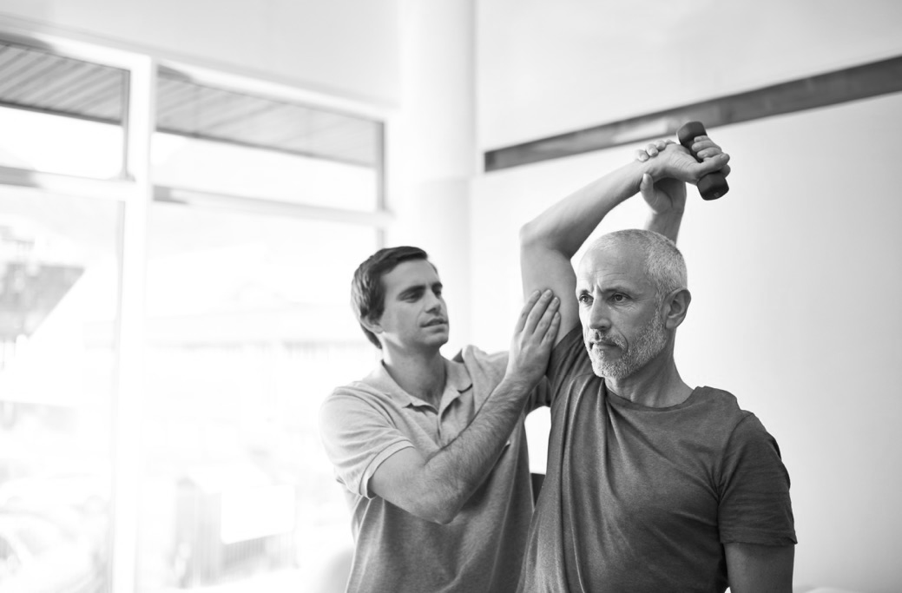
The role and functions of AHPRA and the National Boards are often misunderstood, even amongst internal stakeholders
“Before I came to work here, I didn’t know a lot about AHPRA. I don’t feel there is a level of awareness or understanding in the general community, until someone wants to complain.”
“To be honest I feel that
I have quite a good knowledge of AHPRA… but little to no knowledge of the Boards. All my dealings have been with AHPRA.”

Slide 17

Enhanced communication is supported and encouraged
There is consensus that communication needs to be better targeted, but also more simplified in context and content
Communication is vital. We need to share who we are, what we do and who we are there to help. To be honest, does it really matter who does what? Do the public, or the practitioners for that matter, really need to know what specific roles and functions AHPRA do and similarly what the Boards do? Couldn’t we just have one unified face for the National Scheme?

Slide 18

The survey results support the qualitative insights around the need for enhanced communication…
While the majority of registered practitioners are aware of the National Scheme,
fewer than one in five people (17%) within the broader community are aware of the Scheme.
Awareness of AHPRA is much lower amongst the broader community compared with practitioners but the majority are interested in knowing more about AHPRA and the National Boards.
All registered practitioners are aware of AHPRA and the vast majority (79%) are interested in the role and functions of AHPRA.
Just over one in four adult Australians
(29%) are aware of AHPRA,
(consistent across all key demographics).
While the broader community has less interest than practitioners in the role and functions of AHPRA, half of the adult population (50%) have expressed interest in better understanding the role and functions of AHPRA and the National Boards.

Slide 19

The National Scheme has matured and evolved since establishment
Since 2010, in terms of the effectiveness and efficiency of operations, it has only continued to strengthen considerably over that time. The level of sophistication has improved dramatically, as has the maturity of the scheme itself. It’s been impressive to watch. Well done to all those involved!

Slide 20
The relationships between the key entities are complex and confusing
The broad consensus is that relationships have matured, evolved and improved overtime.
Acknowledgment and understanding that the tone of the relationship and conversation needs to continue to evolve and change from that of:
Complex
Confusing
A ‘beast’
Overwhelming
Constrained
Large
A marriage with no divorce
Collaborative
Efficient
Leaders
To that of:
Effective
Empathetic
Supportive
Proactive
Timely
Constructive

Slide 21
Strong desire from both internal and external Stakeholders for a shared vision and a unified public face
We are in an arranged marriage under the law. Some Boards get upset that people register with AHPRA or deal with AHPRA, when it’s National Boards. But at the end of the day, who cares? As long as we get our job done effectively and timely, it shouldn’t matter. We all work to protect the public. The rest is just an organisational internal structure.

Slide 22
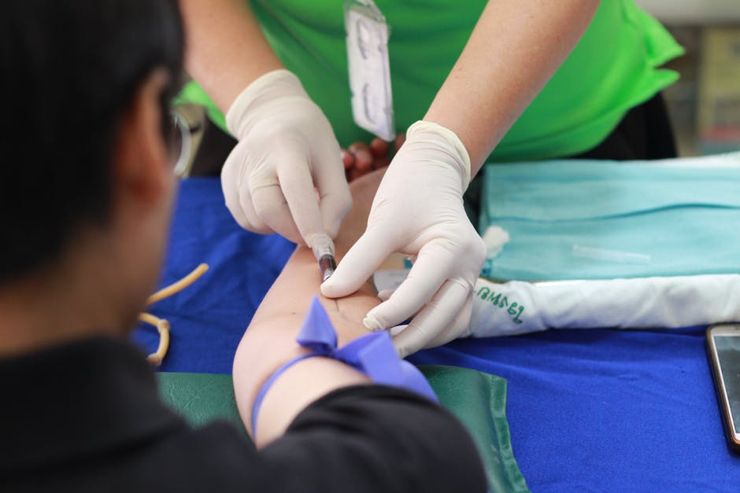
The survey results again support the qualitative insights around confidence and trust in AHPRA…
The largest proportion of practitioners (40%) and
the largest proportion of the broader community (36%) have a positive disposition towards AHPRA.
The practitioners who feel
most positively about AHPRA are:
Nurses and midwives
Occupational therapists
Physiotherapists
The practitioners who express more negative sentiment toward AHPRA (relative to other professions) are:
Medical practitioners
Chiropractors
Chinese medicine practitioners
Dental practitioners
Psychologists

Slide 23
Perceptions of AHPRA
Q. Given your knowledge and understanding of AHPRA and what it does, is your overall view of AHPRA…?
Practitioners
Broader Community*
(Impressions of the 29% who are aware of AHPRA)
Significantly more positive
results amongst:
Nurses: 54%
Occupational Therapists: 53%
Physiotherapists: 49%
No significant differences amongst the broader community
Significantly more negative
results amongst:
Medical practitioners: 26%
Chiropractors: 25%
Chinese Medicine
practitioners: 23%
Dental practitioners: 23%
Psychologists: 21%
Sample Base
Practitioner survey: All practitioners
Community survey: Australians who are aware of AHPRA and indicate they have at least a ‘good’ level of knowledge of AHPRA

Slide 24
Levels of confidence and trust in AHPRA
The survey results indicate significantly higher levels of confidence and trust in AHPRA amongst the general public (that is, the proportion of the general public who have some knowledge of AHPRA) compared with the levels of confidence and trust that practitioners have in AHPRA.
Practitioners
Broader Community
(29% have some knowledge of AHPRA)
Q. Do you feel confident AHPRA is doing everything it can to keep the public safe?
Significantly lower result amongst…
Medical practitioners: 37%
Chinese Medicine practitioners: 39%
Chiropractors: 39%
Dental practitioners: 40%
Psychologists: 44%
No significant differences amongst the broader community
Q. Do you trust AHPRA?
Significantly lower result amongst…
Chinese Medicine practitioners: 33%
Chiropractors: 38%
Medical practitioners: 41%
Dental practitioners: 42%
Psychologists: 50%
Sample Base
Practitioner survey: All practitioners
Community survey: Australians who are aware of AHPRA and indicate they have at least a ‘good’ level of knowledge of AHPRA

Slide 25

The survey results also support the qualitative insights around confidence and trust in National Boards…
The largest proportion of practitioners (43%) have a positive disposition towards their National Board. The largest proportion of the broader community (44%) simply don’t know enough about any National Board to have a view.
The practitioners who feel
most positively about their National Board are:
Occupational therapists
Osteopaths
Optometrists
Nurses and midwives
Physiotherapists
The practitioners who express more negative sentiment toward their National Board
(relative to other professions) are:
Chinese Medicine practitioners
Psychologists
Medical practitioners
Chiropractors
Dental practitioners

Slide 26
Perceptions of National Boards
Q. Given your knowledge and understanding of the National Boards and what they do, what is your overall view of the National Boards? (Community)
Q. Given your knowledge and understanding of (your National Board), what is your overall view of (your National Board)? (Practitioners)
Practitioners
Broader Community*
(Impressions of the 59% who are aware of a Board)
Osteopaths: 59%
Nurses: 55%
Physiotherapists: 51%
Chinese Medicine
practitioners: 19%
Psychologists: 17%
Medical practitioners: 15%
Chiropractors: 15%
Dental practitioners: 13%
No significant differences amongst the broader community
Sample Base
Practitioner survey: All practitioners
Community survey: Australians who are aware of at least one National Board and indicate they have at least a ‘good’ level of knowledge of that board/s

Slide 27
Levels of confidence and trust in National Boards
Once again there are a small number of professions who demonstrated significantly lower levels of confidence and trust in their National Board, compared with other professions. These are the same professions who have less confidence and trust in AHPRA.
Practitioners
Broader Community
(59% have some knowledge of at least one board)
Q. Do you feel confident the National Boards/ your Board is doing everything it can to keep the public safe?
Significantly lower
result amongst…
Medical practitioners: 44%
Dental practitioners: 44%
Psychologists: 45%
No significant differences amongst the broader community
Significantly lower
result amongst…
Medical practitioners: 52%
Chiropractors: 50%
Chinese medicine practitioners: 48%
Dental practitioners: 48%
Psychologists: 47%
Q. Do you trust the National Boards/ your Board?
Sample Base
Practitioner survey: All practitioners registered with that Board
Community survey: Australians who are aware of at least one National Board and indicate they have at least a ‘good’ level of knowledge of that board/s

Slide 28

Key associations with AHPRA (based on the survey results)
While a much smaller proportion of the broader community are aware of AHPRA compared with the proportion of practitioners who know of AHPRA
(29% vs 100%), it is clear that the perceptions of AHPRA amongst the broader community are far more positive than the perceptions typically held by practitioners.
Central to confusion about the role of AHPRA to protect the public versus practitioners…
The broader community are more likely to associate AHPRA as being ‘for practitioners’ (40%) as opposed to being ‘for the public’ (30%).
Conversely, practitioners are more likely to associate AHPRA with being ‘for the public’ (38%) as opposed to being ‘for practitioners (30%).

Slide 29

Key associations with National Boards (based on the survey results)
The largest proportion of both practitioners and the broader community see the National Boards predominantly in terms of being regulators, administrators and necessary.
Beyond that, confusion clearly exists as to the primary remit of the National Boards.
More than one in three practitioners (36%)
view their National Board as being ‘for practitioners’ while 23% associate their National Boards as being ‘for the ‘public’.
Amongst the broader community, more than a quarter (29%) view the National Boards as being ‘for practitioners’ while 23% see National Boards as being ‘for the public’.
Note: A detailed breakdown of the level of confidence and trust in each National Board, as well as a profile of the key associations amongst practitioners with their own National Board is provided in separate reports prepared for each National Board.

Slide 30

‘Transparency’ was THE key factor cited for a successful regulator
Transparency is vital. If people have all the information and understanding, then there are no surprises. Keep them informed, and be honest about things. It will work for you, and make you a trusted regulator.

Slide 31

Greater unity and a sense of shared responsibility is required to support ongoing trust
Not many people external to AHPRA and the Boards realise the differences between what AHPRA and the Boards are. From the public point of view, everybody needs to stay on the same page. It doesn’t take a lot to say we are working on this together, we are reviewing this together. Its important that people see we are working together. That will build trust and confidence in us as a regulator.

Slide 32

There is significant confusion surrounding the branding and visual identify of AHPRA and the National Boards, but there does appear to be a strong connection with the colour of the logo and the ‘map of Australia’
The logo with the reference to the Boards was important when AHPRA was first established and there were only a few Boards impacted, but not now. The symbolism has been established. They don’t need all of the Boards on it anymore. It’s too cumbersome and confusing.
It is the map of Australia that is the clear branding icon. The rest of it is peripheral and in fact
I doubt anyone else even knows that there are multiple versions of the logo.

Slide 33

Looking at visual identity
Has been used for a while so has a history behind it
Communicates a relationship between AHPRA and the Boards
Used effectively in correspondence (although can be ad-hoc by some)
The Australian map communicates that the Scheme is National
Relatively easy to identify
Is effective and clear
Colours used are liked
Emphasis on HP reinforced Health Practitioners
Is relatively well known
Is unifying

Slide 34
Where to from here?
The broad consensus amongst stakeholders was that in 2010, it was important to establish a co-branded logo that identified and unified the many relationships and partnerships, between AHPRA and the Boards.
As a visual device, the logo has, to date, created positive engagement, credibility and acceptance.
With the passing of time, the development of the National Scheme and evolution of the roles and responsibilities, there appears to be an opportunity for refreshment.
While stakeholders are roundly critical of excessive spend on significant logo re-design there is significant discussion about the need to simplify the visual device used to represent AHPRA and the National Boards.
The transition of paramedicine to regulation was considered an appropriate time to take the next step in refreshing the visual identity.
I think that brand recognition is fairly high. The ongoing confusion is about who is responsible for what, is an issue. Looking at our logo, I'm not sure how well it achieves its intent. It's identifiable - but... is it the Boards or AHPRA? What does it say about the National Scheme? What does it mean to the public?

Slide 35
Moving forward there is a need for simplicity to manage confusion
There is no doubt that there exists a complex relationship between AHPRA and the Boards.
One which produces confusion, clutter and complexities from a brand perspective. But in order to be effective moving forward and present a unified brand identity, its going to be vital that its simple and straightforward.

Slide 36
Let’s discuss – next steps
1. Getting to know the report
  Agency Management Committee
  National Boards
  National Executive
2. How to we best use the report
  Policy – analysis, implications and learning
  Connecting to our ongoing work
  Visual identity – what are our options?

